Slide 1



https://facebook.github.io/react/docs/installation.html
Angel Sullon Macalupu

Slide 2
React App
<!doctype html>
<html lang="en">
<head>
<meta charset="utf-8">
<meta name="viewport" content="width=device-width, initial-scale=1">
<title>React App</title>
</head>
<body>
<div id="root"></div>
<script src="bundle.js"></script>
</body>
</html>
ReactDOM.render(
<Layout />,
document.getElementById('root')
);

Slide 3
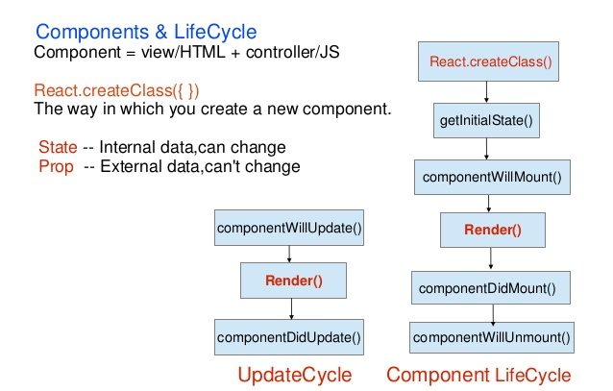

Slide 4
Layout example
Title
Header
title
Footer

Slide 5
React Components Usage
import React from "react";
export default class Title extends React.Component {
render() {
return (
<h1>{this.props.title}</h1>
);
}
}
import React from "react";
import Title from "./Header/Title";
export default class Header extends React.Component {
handleChange(e) {
const title = e.target.value;
this.props.changeTitle(title);
}
render() {
return (
<div className="container">
<Title title={this.props.title} />
<input value={this.props.title} onChange={this.handleChange.bind(this)} />
</div>
);
}
}

